Slide 1
Learn About Antibiotic Resistance
Nidhi Naik, Jennifer Kim, Ena Oboh, Bitania Berhane

Slide 2
MAIN MENU
Choose a story to follow:
STORY #1
STORY #2
STORY #3
STORY #4

Slide 3
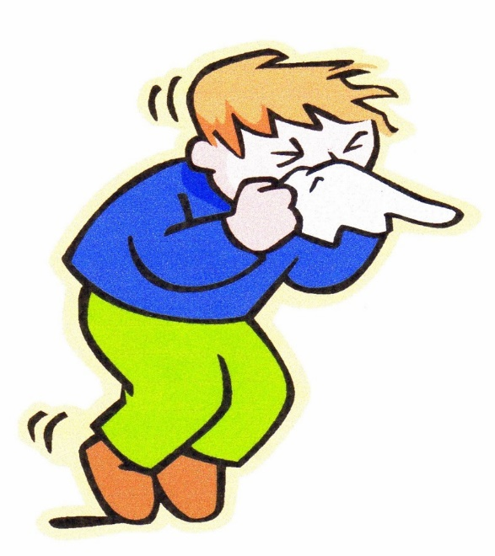
Jane wakes up feeling sick, almost like she has the cold, one morning.
Should she go the doctor?
YES
NO
This Photo by Unknown Author is licensed under CC BY-NC-ND

Slide 4
The doctor says that she has an upper respiratory tract infection. The doctor then gives her a prescription. She feels really tired and does not really feel like going to the pharmacy.
Should she fight through her fatigue and still go?
YES
NO

Slide 5
She decides to just go ahead and get her prescription. After a few days she starts to feel a little better. She thinks that she does not need to keep taking the medication.
Should she still take the medication?
YES
NO

Slide 6
She feels better and since she took all her medication, she has not contributed to antibiotic resistance.
Main Menu

Slide 7
She ends up feeling fine for a few days, but she keeps getting the infection and it gets harder to treat every time. She has now contributed to the antibiotic crisis.
Main Menu
DID YOU KNOW?
Bacteria that lived through the first round of antibiotics can reproduce and pass resistance to their offspring

Slide 8
Jane goes home and gets some sleep. She never gets her medication. She only feels sicker as time goes on.
Should she get the medication now?
YES
NO

Slide 9
She gets the medication and she starts to feel better. After a few days, she starts to feel a little better. She thinks that she does not need to keep taking the medication.
Should she still take the medication?
YES
NO

Slide 10
She ends up getting sicker and sicker and eventually falls too ill to treat.
Main Menu

Slide 11
She ends up getting sicker and sicker and eventually falls too ill to treat.
Main Menu

Slide 12
Mary Sue is an up and coming chicken farmer. She was sent 100 new chickens for the season. The new farmer handbook advised for her to use antibiotics to ensure the chickens do not get ill. But Mary Sue does not know what antibiotics are or how they work.
What should she do?
Give the chickens antibiotics
Don’t give them antibiotics
sba. (2019). Cute Farm Girl [Image]. Retrieved from https://eng.ohmyfiesta.com/2017/09/cute-farm-for-girls-clip-art.html

Slide 13
Your chicken get a bacterial infection and die within a week. Looks like Mary Sue will need some new chicken. Sorry!
Main Menu
DID YOU KNOW: Animals that take antibiotics develop antibiotic resistance bacteria in their gut. If this meat is not cooked or handled properly, the resistant antibiotics can spread to humans!

Slide 14
The chicken has been successfully growing few weeks. But suddenly, multiple chickens are sneezing and the rooster cannot “cockle-doodle-doo”. Mary Sue is scared! What should she do?
Call the veterinarian ASAP!
Leave the chickens alone.
Rollera LLC. (2019). Blank Pill Bottle [Image]. Retrieved from http://www.clker.com/clipart-blank-pill-bottles.html

Slide 15
The vet diagnoses your chicken with upper respiratory tract infections and prescribes them Terramycin.
CHECK TO SEE HOW THEY
ARE DOING
DID YOU KNOW: Antibiotics work by destroying the bacterial cells without harming the eukaryotic cells. Bacterial cells have components that eukaryotic cells do not have such as a cell wall. Terramycin works by inhibiting the creation of gyrase, which helps bacteria replicate DNA.

Slide 16
The infection spreads from chicken to chicken and the flock dies. Maybe Mary Sue should change her profession...
EXPLORE MORE

Slide 17
Within a week or so, the chickens symptoms are improving! But Mary Sue wants to know if her use of antibiotics is affecting more than just her chicken.
EXPLORE MORE

Slide 18
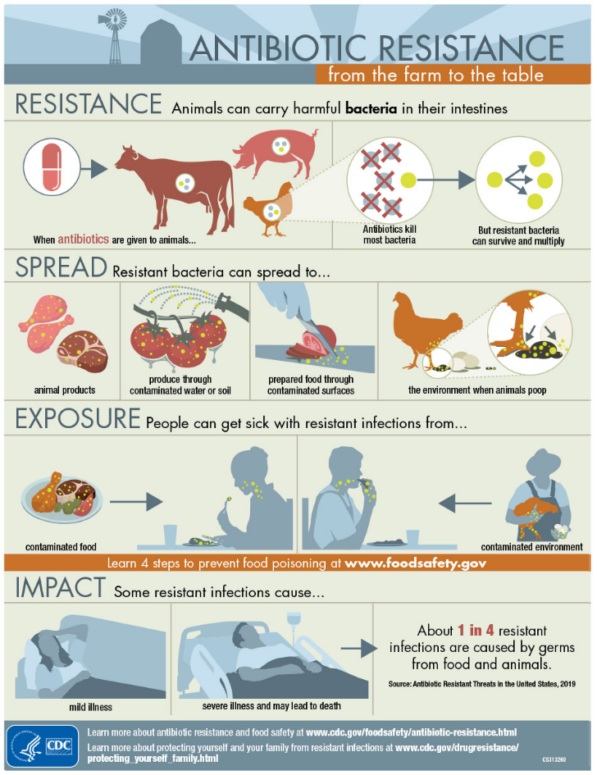
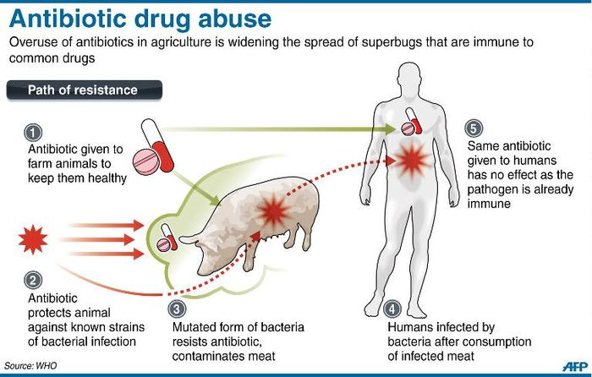
i24 NEWS. (2019). Antibiotic Drug Use [Image]. Retrieved from https://www.i24news.tv/en/news/international/94932-151208-agricultural-antibiotic-use-is-making-humans-resistant-to-crucial-drugs-report
CDC. (2019). Antibiotic Resistance from the farm to the table [Image]. Retrieved
from https://www.cdc.gov/foodsafety/images/ar-infographic-950px.jpg
There are always a few antibiotic resistant bacteria in someone’s body. When someone takes antibiotics, good and bad bacteria are killed. The resistant bacteria are able to take over and can pass the resistant gene on to other bacteria.
Main Menu

Slide 19
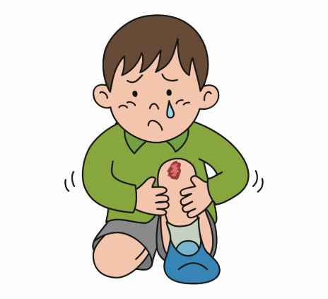
Thomas is a 6-year-old, hyperactive child who loves going to the playground. One day, he is injured during recess at school. Despite this, he wants to go to the playground after school to enjoy the rest of the day. His mother is deciding whether to let the wound “air out” while he plays or to disinfect the wound and wrap it up before he is allowed to play.
What decision should be made?
Thomas's mother should allow him to play
while the wound “airs out”
Thomas’s mother should disinfect the wound,
wrap it up and advise him to stay home before he
can play.
https://webstockreview.net/explore/knee-clipart-child-hurt/

Slide 20
Thomas is allowed to play in the playground by his apartment complex. He uses the swing set, slide, see saw, and tires with all his new friends till the day goes dark. At night time, Thomas falls ill and is running a high fever.
Should Thomas’s mother rush him to an urgent care facility/ER or self-medicate him?
Urgent Care Facility/ER
Self-Medicate

Slide 21
Thomas’s mother disinfects the wound, wraps it up and ensure he stays home for a few days before he is allowed to play. This prevents Thomas from contracting any possible bacterial infections which will require the use of antibiotics
EXPLORE MORE

Slide 22
Thomas’s mother rushes him to an urgent care facility/ER where it is determined that he has contracted a bacterial infection through the open wound on his knee. He has unfortunately contracted antibiotic resistance through the unsanitary playground
EXPLORE MORE
DID YOU KNOW?
Antibiotic Resistance can be spread through surfaces

Slide 23
Thomas starts to get sicker and sicker over the next few days. Finally his mother takes him to the ER. There he is found to have a bad bacterial infection. However, he has unfortunately contracted antibiotic resistance through the unsanitary playground
EXPLORE MORE

Slide 24
https://2019.igem.org/Team:ASTWS-China/Description
Main Menu

Slide 25
Johnny is the boy who lives in a rural area where many people suffer from hunger. He and his family get a shower once every two weeks, trying to save money to buy food. They barely survive from the money they get from the government.
At night, Johnny's sister was not feeling well and had diarrhea. The diarrhea did not stop until 3 AM. She was feeling exhausted and took some medicine with a cup of water that was on the dining table. It calmed the diarrhea temporarily, but it came back with even more pain.
Should his family take her to the doctor?
YES
NO

Slide 26
His family took her to the doctor and diagnosed that she was infected with the bacteria called Vibrio Cholerae. She now has Cholera. She then denies that there is no way she could get the disease. Then doctor tells her that contaminated water or improperly cooked food can give her the bacteria. Then she remembers she had the water that was placed on the table. The family then asked the doctor what can be done. The doctor advises that Cholera is highly treatable.
What should she do?
Takes the medications/ antibiotics to stop the growth of the bacteria. She has not contributed to antibiotic resistance
Leave it until it naturally heals and contributing to antibiotic crisis.

Slide 27
The medicine will stop the growth of the bacteria and make her feel better than before. Continuing the medications will help her battle the disease.
Main Menu

Slide 28
If she is lucky and successfully battles the disease, then she will be okay. However, she will be sick most likely again.
Main Menu

Slide 29
She took the medicine again and temporarily became good. However, the growth of bacteria worsened and she felt a horrible pain in her intestines. She even feels dehydrated. She ended up at Emergency Room. Doctors came to her and told her that the disease got worse and she needs to take treatments at the hospital.
Should she stay at the hospital and take medications or she should just go home and sleep?
Take Medicine
Go Home

Slide 30
She went home and slept. In the middle of the night, she died from a hypovolemic shock due to severe dehydration.
Main Menu

Slide 31
At the beginning, she vomited and felt dehydrated easily. Over the time, after taking the medications to stop the growth and taking good care of the body eventually cured the disease.
Main Menu

